Slide 1


Slide 2
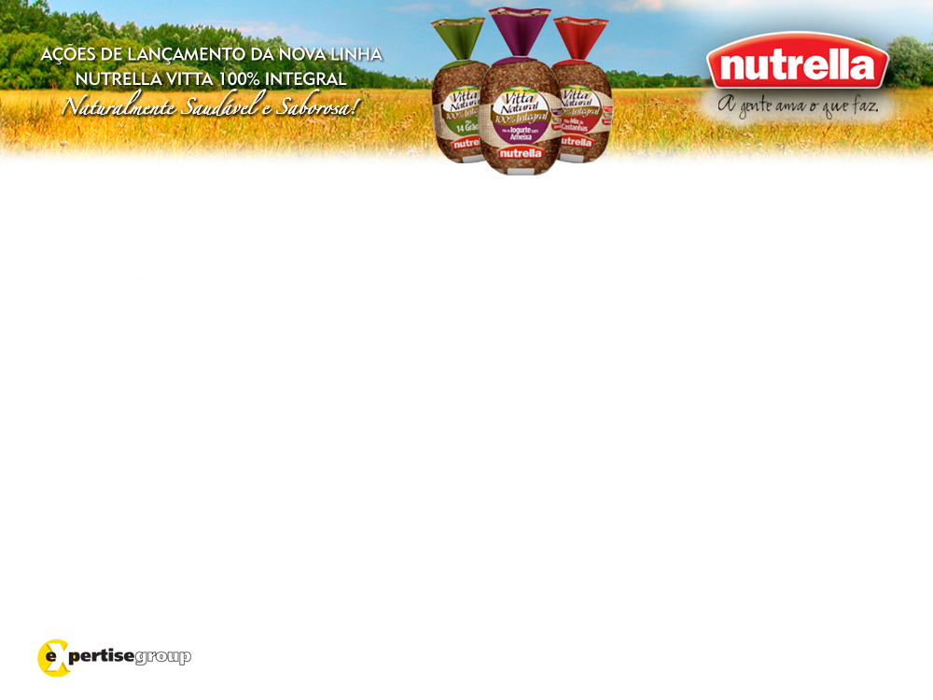
Launching Strategy
Nutrella’s Vitta Natural bread line
100% Whole Wheat
April/2009

Slide 3
Briefing
Goals
- Launch the new line of products and its three different versions:
Plum and Yogurt, 14 Grains and Nuts.
- Reinforce brand’s perception as Innovative, its Uniqueness and increase Trial Tasting;
Extra-Outcomes
- Generate new Costumers;
- Increase Nutrella’s market share, consolidating its leadership.

Slide 4
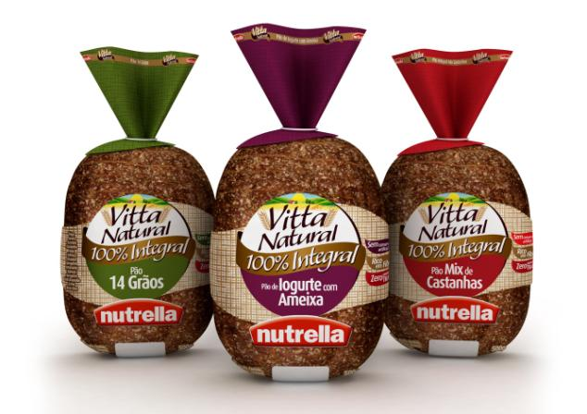
Briefing
Product
The new line Nutrella Vitta Natural 100% Whole Weat
3
Exclusive Versions
Fruits
Healthy, balanced and nutritious nourishment
Nuts
Seeds
Sharing the same positive aspects of the Nutrella brand
Quality
freshness, tenderness and taste
Innovation
Healthiness
consumer well-being
Affordability
Trustworthy
honest

Slide 5
?
How to make it
!
being noticed
at the POP?
being perceived
as different?
Differentiation
two main aspects
rightly
delivering
positioning
the message
this product line
to the target
Our launching strategy and its Activation, Sampling (tasting) and Partnership actions are sustained by those two pillars.

Slide 6



!
Differentiation
rightly
positioning
this product line
“Guess what? Just saw at the market an ultra healthy product that seems to be so tasty.
I’ll definitely give it a try!”
“Wow, Nutrella is natural and a 100% whole wheat. It must
be really healthy!”
“Those new flavours are so tasty.
In addition to that, there are no artificial conservatives!”
desired consumer belief

Slide 7
!
Differentiation
rightly
positioning
this product line
“Guess what? Just saw at the market an ultra healthy product that seems to be so tasty.
I’ll definitely give it a try!”
“Wow, Nutrella is natural and a 100% whole wheat. It must
be really healthy!”
“Those new flavours are so tasty.
In addition to that, there are no artificial conservatives!”
healthiness
Where, When and How
and well-being
POSITIONING
actions will be developed

Slide 8

WHO is our target?

Slide 9

WHO is our target?
Woman
AB+
25 - 44 years old
Urban and Active
Independent
Individual Consumer
Living in great
urban areas

Slide 10
WHO is our target?
WHAT does she want?
Woman, AB+, 25 - 44
Urban and Active, Independent
Living in great urban areas
Physical and Mental balance
Interested on:
- Health, well-being and quality of life – 78%
- Beauty care and Aesthetics – 69%
- Diet and
Nutrition – 64%
- Fashion – 60%
- Ecology and Environment – 56%
Source: Ipsos Marplan apr/07 to mar/08 - 9 markets – Target: MM 10+

Slide 11
WHO is our target?
WHAT does she want?
WHERE is she?
Woman, AB+, 25 - 44
Urban and Active, Independent
Living in great urban areas
Physical and Mental
balance
Health, well-being and quality of life
Commute
Work
Books
Bookshop
Airport
Magazines
Coffee Shop
Email
Home
Internet
Online Store
Supermarket
Park
Salon
Gym
Movie
Theatre
Restaurant
Mall
Pub
Night out

Slide 12
WHO is our target?
WHAT she wants?
WHERE is she?
Woman, AB+, 25 - 44
Urban and Active, Independent
Living in great urban areas
Physical and Mental
balance
Health, well-being and quality of life
Commute
Work
Commute
Books
Books
Bookshop
Bookshop
Airport
Magazines
Magazines
Coffee Shop
Email
Email
Internet
Home
Internet
Online Store
Positioning!
Online Store
Supermarket
Supermarket
Healthiness and well-being
Park
Park
Salon
Gym
Gym
Movie
Theatre
Restaurant
Restaurant
Mall
Pub
Night out

Slide 13
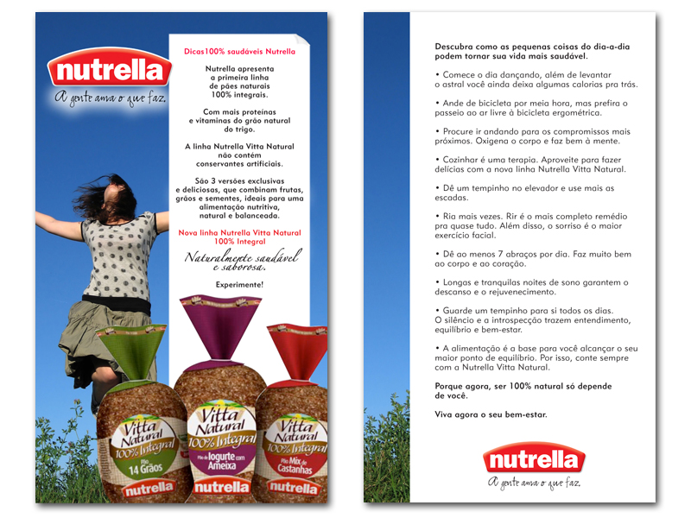
All-Purpose Material
Folder 100% Healthy Tips Nutrella
Emphasizing the launching
properties and positioning
Unique content
funny and curious
activities to a healthier living, increased well-being
Acknowledgement
improved value perception and legacy
improved spreading potencial

Slide 14
Start the day dancing.
Besides cheering you up it stills leaves some calories behind.
Cooking is therapeuthical.
Take advantage of Nutrella’s new Vitta Natural line to bake your problems away.
Give the elevator a break and try using the stairs to reach adjacent floors.
Give at least 7 hugs a day.
It is goodness for the body and the heart.
All-Purpose Material

Slide 15
Activation
Strategy
Commute
Work
Books
Bookshop
Airport
Magazines
Coffee Shop
Email
Home
Internet
Online Store
Supermarket
Park
Salon
Gym
Movie
Theatre
Restaurant
Mall
Pub
Night out

Slide 16
Activation
Strategy
Commute
Work
Books
Bookshop
Airport
Magazines
Coffee Shop
Email
Home
Internet
Online Store
Supermarket
Park
Salon
Gym
Movie
Theatre
Restaurant
Mall
Pub
Night out

Slide 17


Activation
Strategy
Tray Tastings
Promoters wearing branded outfits
Natural material tray (or look-like)
All-purpose folder - positioning
São Paulo, Porto Alegre, Curitiba, Florianópolis and neighbourhoods, for 01 month, being:
Commute
Work
Books
Bookshop
Airport
Magazines
Coffee Shop
Email
Home
Internet
Online Store
Supermarket
10 stores SP x 04 weeks = 20 stores
05 stores CTB x 04 weeks = 10 stores
05 stores FLN x 04 weeks = 10 stores
05 stores POA x 04 weeks = 10 stores
Park
Salon
Gym
Movie
Theatre
Restaurant
Mall
Pub
Night out

Slide 18
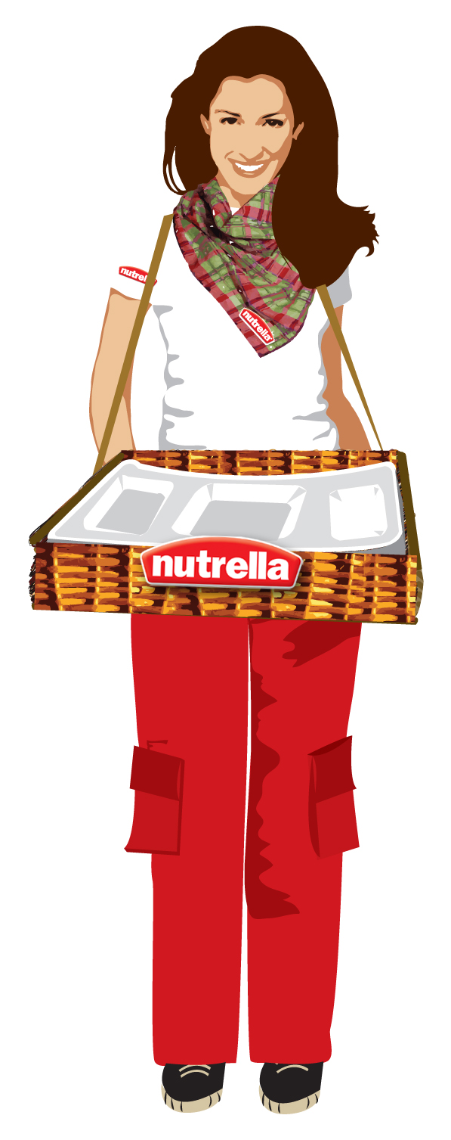
Tray Tastings

Slide 19
Activation
Strategy
Commute
Work
Cross Merchandising
Books
Bookshop
Airport
Magazines
Relating it to products that share the same benefits of healthiness and well-being
Displaying side-by-side with products such as:
Coffee Shop
Email
Home
Internet
Online Store
Low Fat Cheeses
Turkey Breast
Light Cream Cheese
“Taeq” line of products – Pão de Açúcar
Supermarket
Park
Salon
Gym
Movie
Theatre
Restaurant
Mall
Pub
Night out

Slide 20
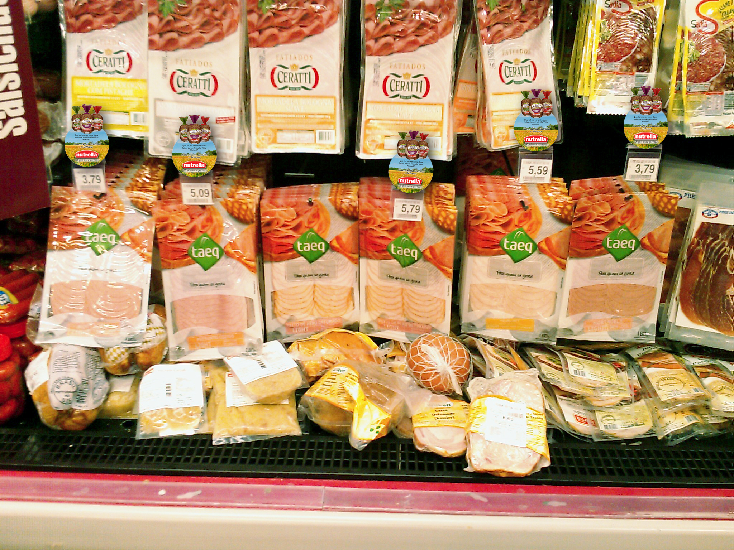
Cross Merchandising

Slide 21

What about seeing me between two slices of Nutrella Vitta Natural?
Cross Merchandising

Slide 22

I am 100% light. Nutrella Vitta is 100% natural... What about you?
Cross Merchandising

Slide 23

Is it healthy? In this case I prefer Nutrella Vitta Natural.
Cross Merchandising

Slide 24
Activation
Strategy
Commute
Work
The Nutrella Market
Books
Bookshop
Airport
Magazines
Unique approach
10 main stores
Associating to products that highlights:
Coffee Shop
Email
Home
Internet
Online Store
its ingredients
its freshness
its healthiness
Supermarket
Park
Salon
Gym
Design - “freshness” and “healthiness”
Movie
Theatre
Restaurant
Mall
Pub
Night out

Slide 25
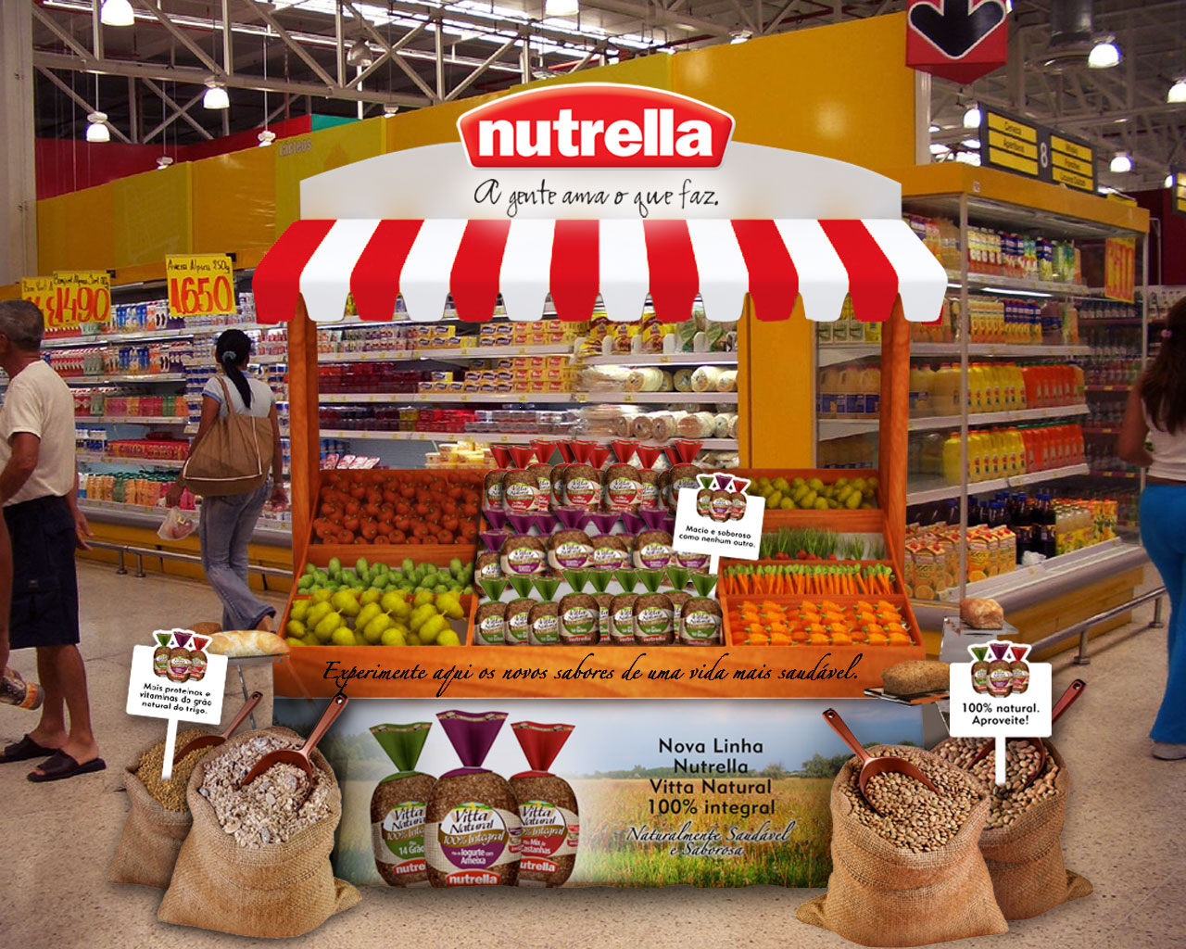
The Nutrella Market

Slide 26
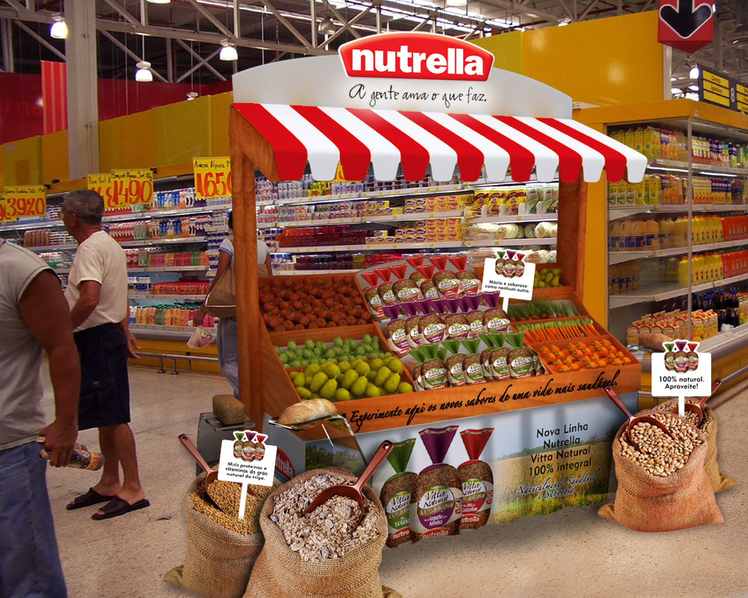
The Nutrella Market

Slide 27
Activation
Strategy
Commute
Work
Books
Bookshop
Airport
Magazines
Coffee Shop
Email
Home
Internet
Online Store
Supermarket
Park
Salon
Gym
Gym
Movie
Theatre
Restaurant
Mall
Pub
Night out

Slide 28

Activation
Strategy
Pilates and Yoga
Commute
Work
Books
Sponsored open classes
Associating to classes that focus on healthiness and well-being (not impact nor performance)
Brand exposition:
Bookshop
Airport
Magazines
Coffee Shop
Email
Home
Internet
mats
In-class mirror stickers
In-class glass stickers
Teachers and Supervisors t-shirts
Online Store
Supermarket
Park
Saloon
Gym
Gym
Movie
All-Purpose Folder delivery
Disclosure – 15 days prior
Theatre
Restaurant
Mall
Pub
Night out

Slide 29
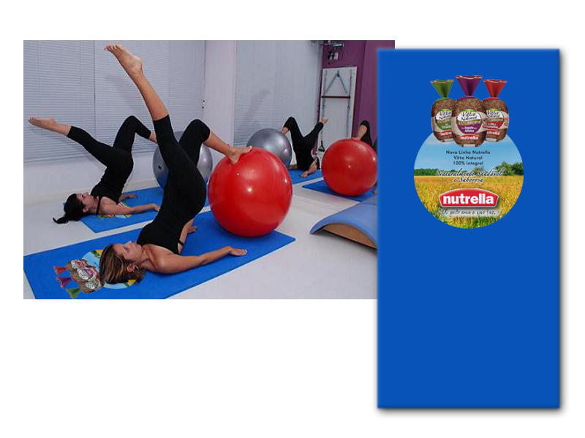
Pilates and Yoga (mats)

Slide 30

Pilates and Yoga (mats)

Slide 31
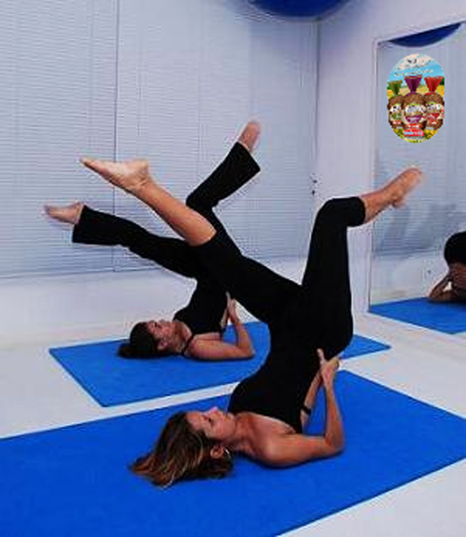
Pilates and Yoga (sticker)

Slide 32

Pilates and Yoga (sticker)

Slide 33
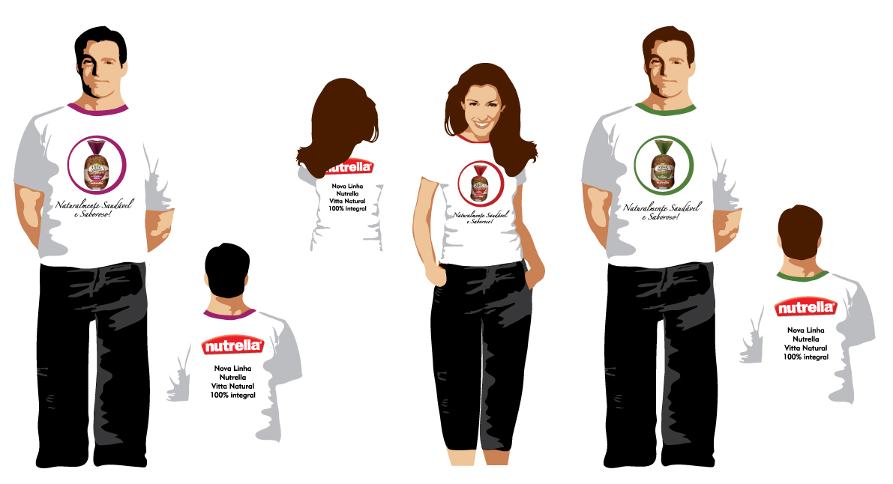
Pilates and Yoga (t-shirts)

Slide 34
Activation
Strategy
Commute
Work
Books
Breakfast and Afternoon Snack
Bookshop
Airport
Magazines
Sampling table
Rush hours
Coffee Shop
Email
Home
Internet
breakfast
afternoon snack
Online Store
Supermarket
Park
Light and healthy meal
Promoters wearing branded outfits
All-Purpose Folder delivery
2 times a week, both hours
Saloon
Gym
Gym
Movie
Theatre
Restaurant
Mall
Pub
Night out

Slide 35
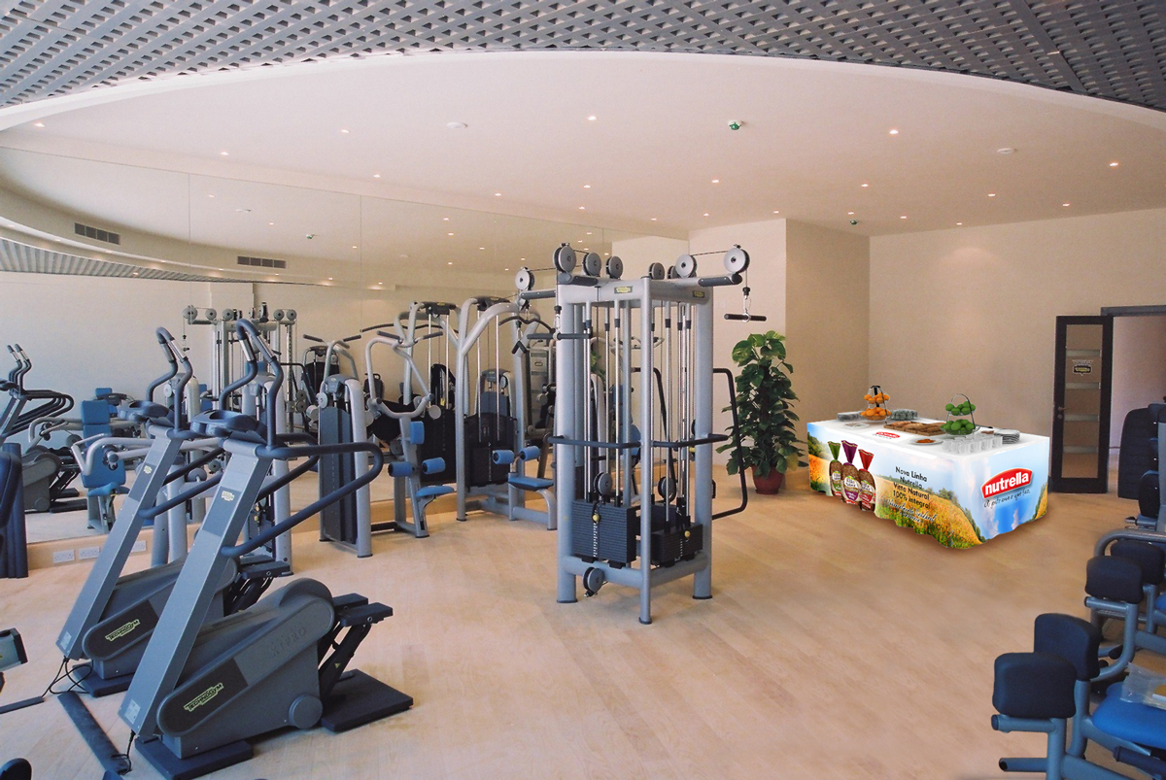
Breakfast/ Afternoon Snack

Slide 36
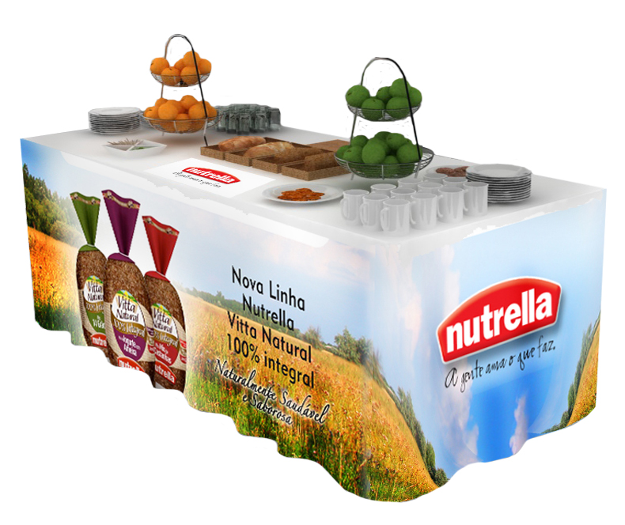
Breakfast/ Afternoon Snack

Slide 37
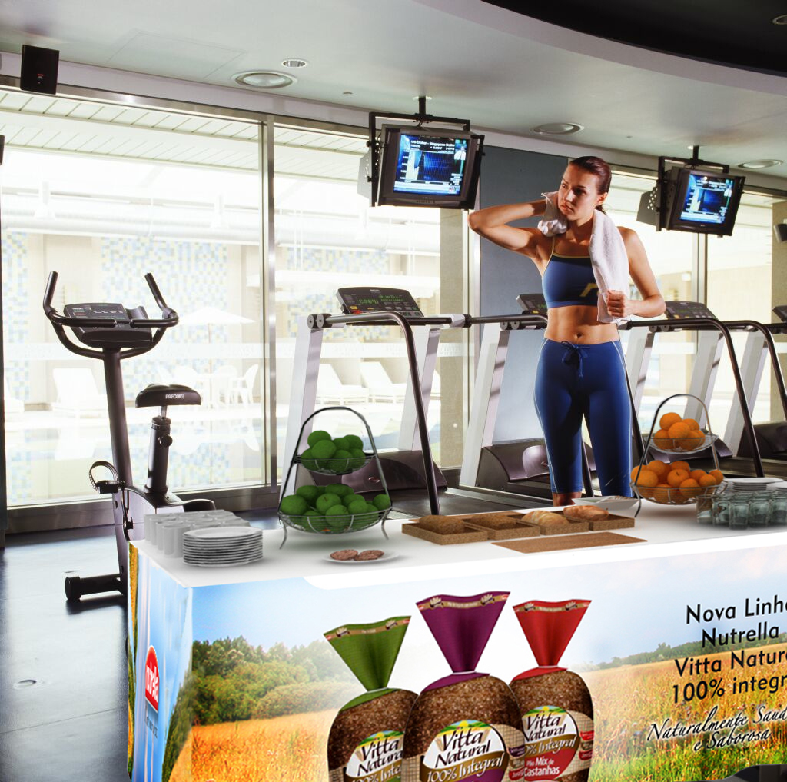
Breakfast/ Afternoon Snack

Slide 38
Activation
Strategy
Nutrella Healthy Menu
Commute
Work
Partnering with Gym’s Cafeterias
Special menu
Books
Bookshop
Airport
Magazines
3 exclusive sandwich options
light and healthy
inspired by the product’s 3 new tastes
Coffee Shop
Email
Home
Internet
Online Store
Ingredients offered as bonuses – stimulating adherence
Subsidized prices – stimulating tasting
Branded flag
All-Purpose Folder delivery
Supermarket
Park
Saloon
Gym
Gym
Movie
Theatre
Restaurant
Mall
Pub
Night out

Slide 39
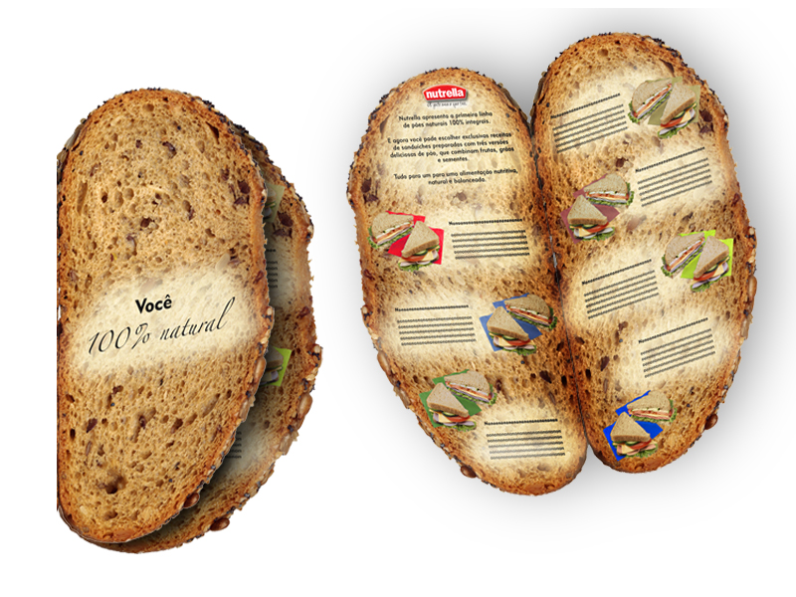
Healthy Menu

Slide 40
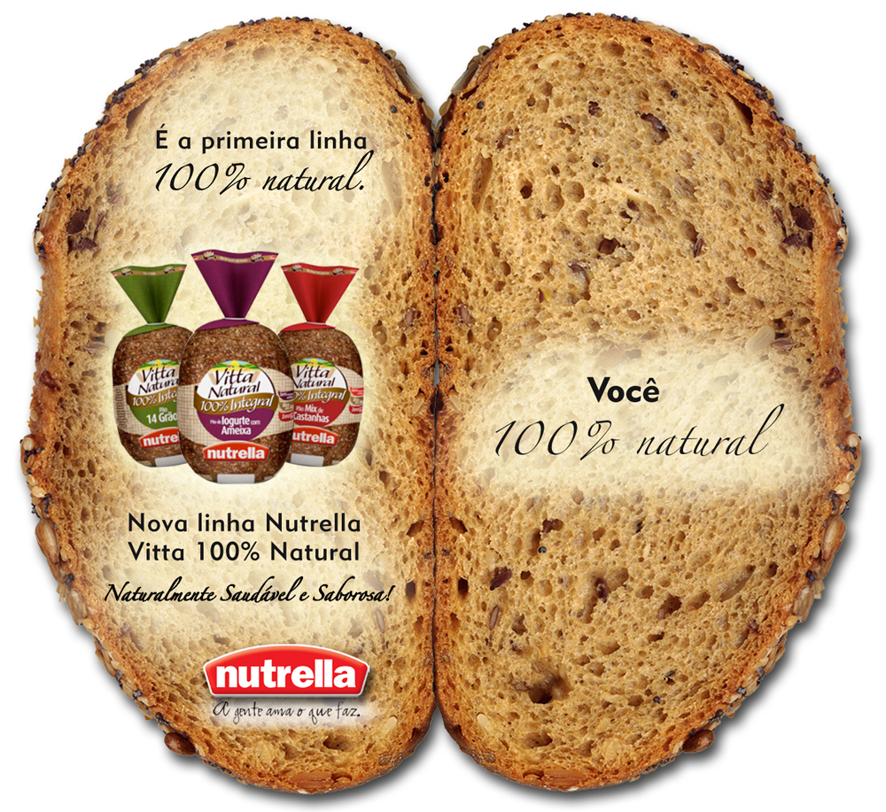
Healthy Menu (outside)

Slide 41
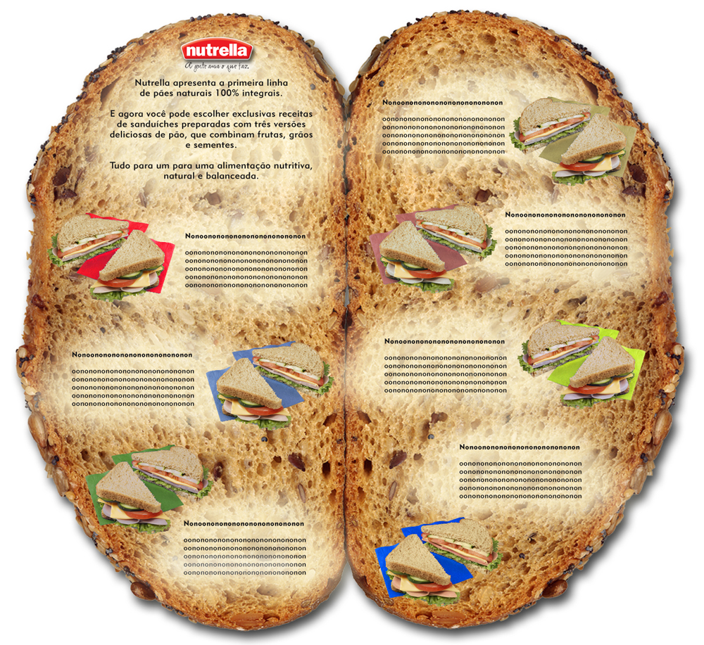
Healthy Menu (inside)

Slide 42
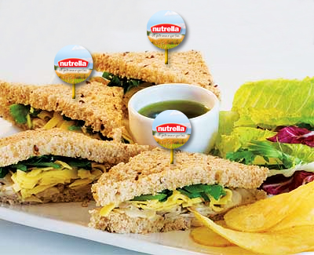
Healthy Menu (branded flag)

Slide 43
Activation
Strategy
Commute
Work
Books
Bookshop
Airport
Magazines
Coffee Shop
Email
Home
Internet
Online Store
Supermarket
Park
Salon
Gym
Gym
Movie
Theatre
Restaurant
Restaurant
Mall
Pub
Night out

Slide 44
Activation
Strategy
Commute
Work
Books
Bookshop
Airport
Nutrella’s Sponsored Couvert
Magazines
Coffee Shop
Couvert option – selected restaurants
Email
served with butter or natural sauces that highlights its flavours.
Home
Internet
Online Store
Supermarket
Healthy and light restaurants - positioning
Unique basket – natural feel
All-Purpose Folder delivery
Park
Saloon
Gym
Gym
Movie
Theatre
Restaurant
Restaurant
Mall
Pub
Night out

Slide 45
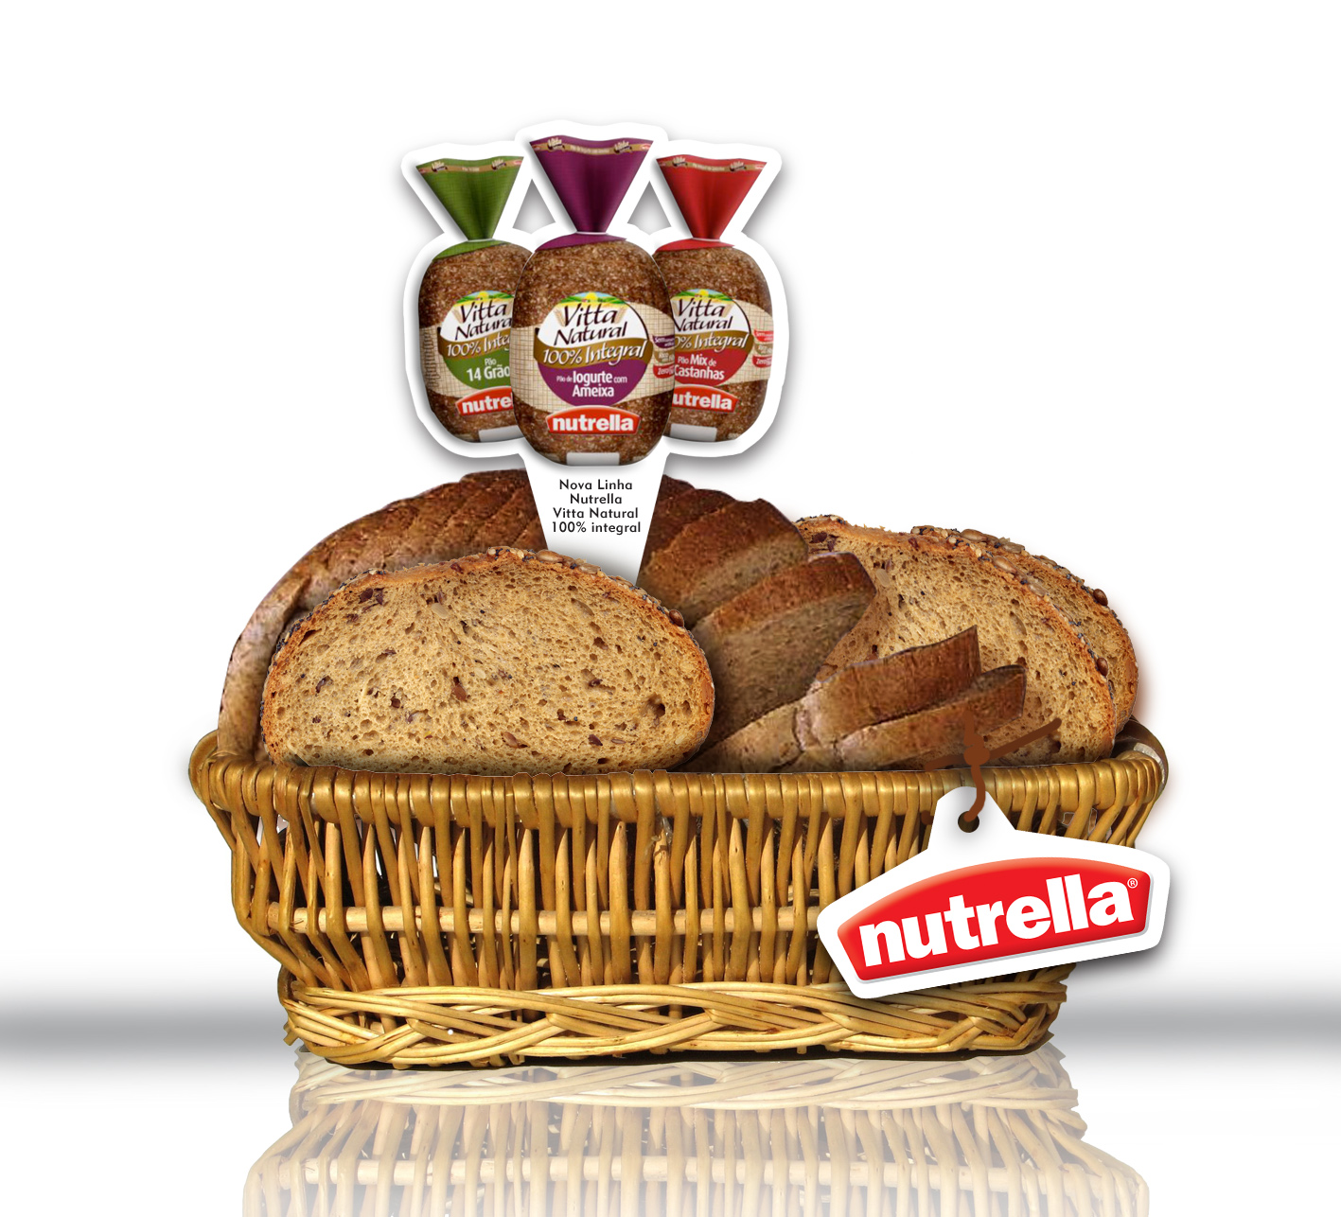
Sponsored Couvert

Slide 46
Activation
Strategy
Commute
Work
Books
Bookshop
Airport
Magazines
Nutrella’s Sponsored Couvert
Coffee Shop
Email
50 restaurants (20 baskets/ each), being:
Home
Internet
São Paulo – 20
Curitiba – 10
Florianópolis – 10
Porto Alegre – 10
Online Store
Supermarket
Park
Saloon
Gym
Gym
Movie
Breads offered as bonuses (free of charge) by Nutrella
Theatre
Restaurant
Restaurant
Mall
Pub
Night out

Slide 47
Activation
Strategy
Commute
Work
Books
Bookshop
Bookshop
Airport
Magazines
Coffee Shop
Email
Home
Internet
Online Store
Supermarket
Park
Salon
Gym
Gym
Movie
Theatre
Restaurant
Mall
Pub
Night out

Slide 48
Activation
Strategy
Nutrella’s Shelf
Commute
Work
Unique Display
Books
Bookshop
colours
product branding visual guideline
Bookshop
Airport
Magazines
Coffee Shop
Set up with stores’ healthy and well-being product lines:
Email
Home
Internet
Online Store
Magazines, books, DVDs
Supermarket
Park
Association = Positioning
All-Purpose Folder take-one
Unique service = Convenience
Saloon
Gym
Gym
Movie
Theatre
Restaurant
Mall
Pub
Night out

Slide 49
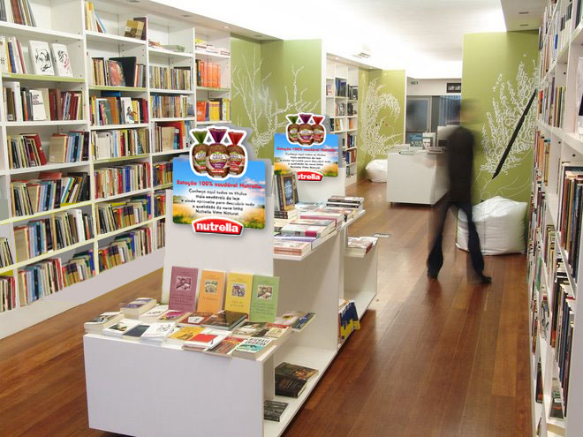
Nutrella’s Shelf

Slide 50

Nutrella’s Shelf

Slide 51
Activation
Strategy
Commute
Work
Book Marker
Books
Bookshop
Bookshop
Airport
Magazines
Delivered to every costumer – check-out
Spreading the message
Coffee Shop
Email
Home
Internet
Online Store
Supermarket
Park
Salon
Gym
Gym
Movie
Theatre
Restaurant
Mall
Pub
Night out

Slide 52
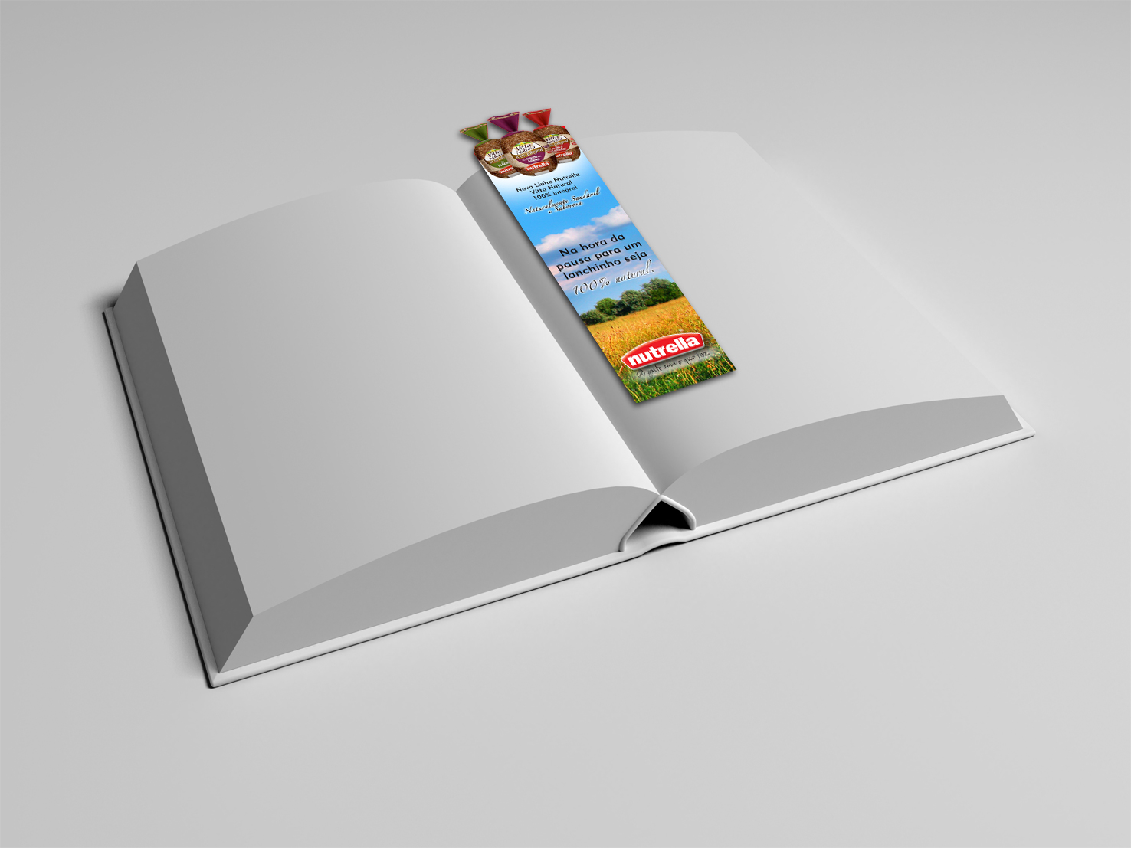
Book Marker

Slide 53

When it comes to a break, be 100% natural.
Book Marker

Slide 54
Activation
Strategy
Commute
Work
Books
Bookshop
Bookshop
Airport
Magazines
Coffee Shop
Email
Internet
Home
Internet
Online Store
Supermarket
Park
Salon
Gym
Gym
Movie
Theatre
Restaurant
Mall
Pub
Night out

Slide 55
Activation
Strategy
Nutrella’s Virtual Shelf
Commute
Work
Virtual store – Partnership
Books
Bookshop
Submarino or Americanas.com
Bookshop
Airport
Magazines
Sponsor a virtual store to offer:
Coffee Shop
Health products
Woman well-being
Email
already sold through these sites
Internet
Home
Internet
Online Store
Supermarket
Brand visual guidelines
Banners - link to Nutrella’s hotsite
Sponsor - e-mail marketing = acknowledgement
Park
Saloon
Gym
Gym
Movie
Theatre
Restaurant
Mall
Pub
Night out

Slide 56
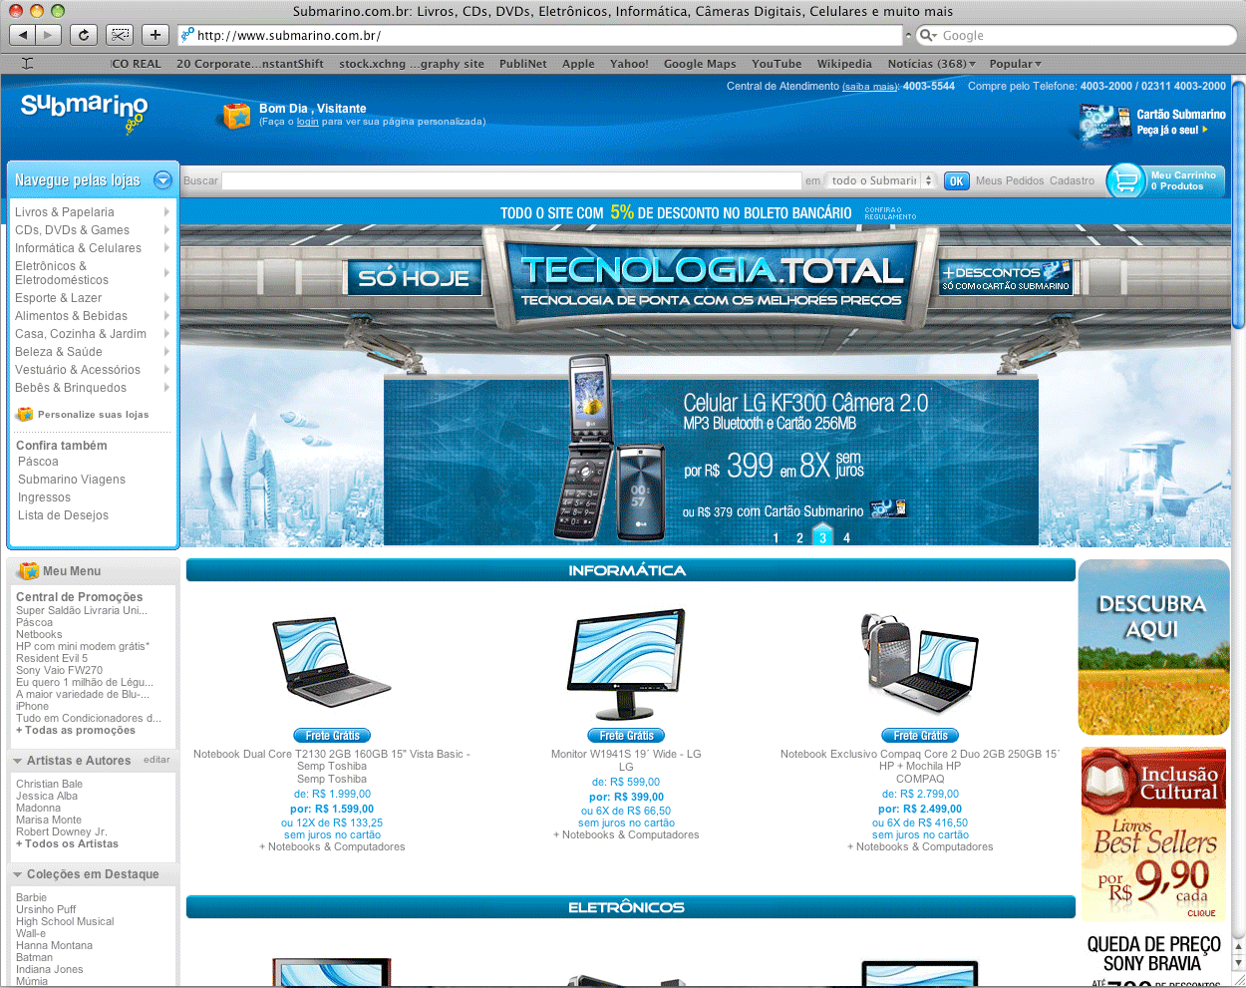
Virtual Shelf (banner home)

Slide 57
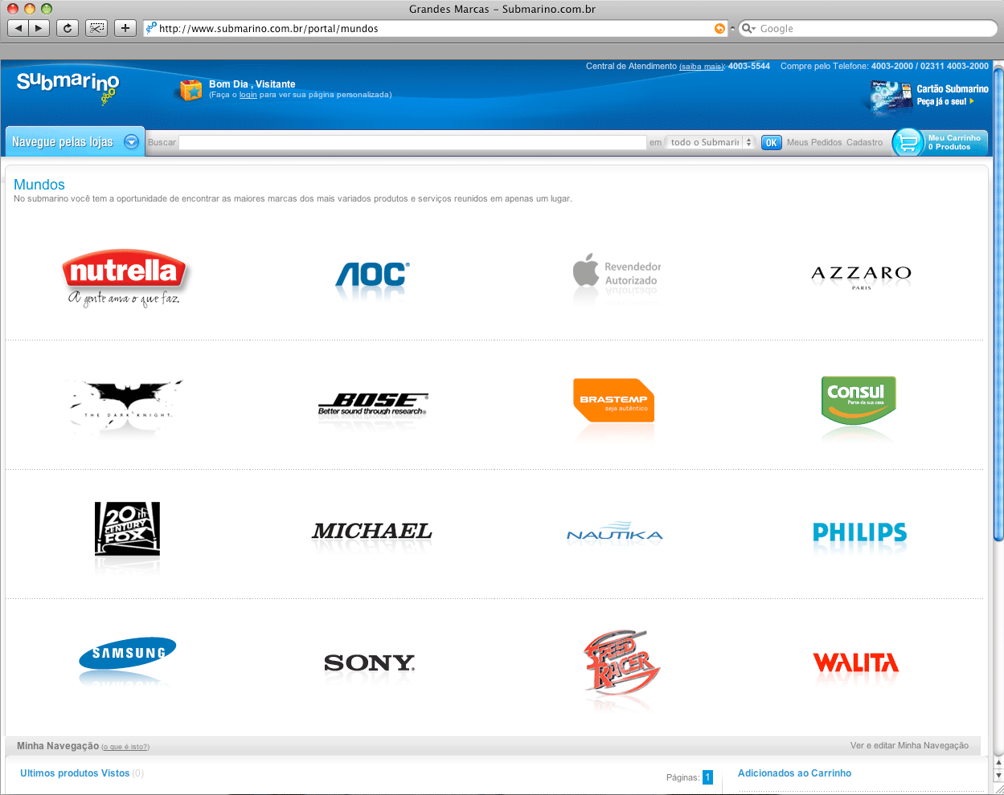
Virtual Shelf (“World” section link)

Slide 58
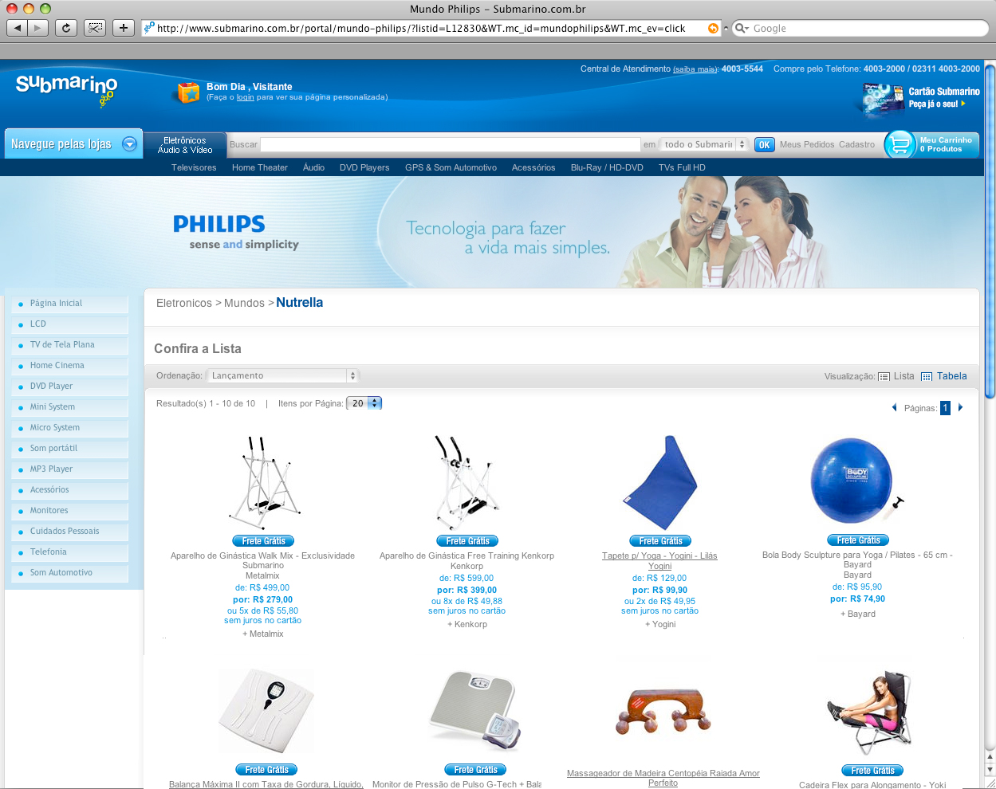

Virtual Shelf (store)

Slide 59
Activation
Strategy
Commute
Work
AdWords
Books
Bookshop
Bookshop
Airport
Same airing schedule as the virtual shelf
Magazines
Keywords programming - Google
Coffee Shop
Email
First result for
specific searches
increased
acknowledgement
Internet
Home
Internet
Online Store
Supermarket
Words like:
Park
Health, Well-being, Woman, Store, Grains, Oats, Bread, Beauty, Wholewheat, Female
Saloon
Gym
Gym
Movie
Theatre
Restaurant
Mall
Pub
Night out

Slide 60
Activation
Strategy
Commute
Work
Books
Bookshop
Bookshop
Airport
Magazines
Coffee Shop
Email
Internet
Home
Internet
Online Store
Supermarket
Park
Park
Salon
Gym
Gym
Movie
Theatre
Restaurant
Mall
Pub
Night out

Slide 61
Activation
Strategy
Commute
Work
Books
Bookshop
Bookshop
Airport
Magazines
Nutrella Sportsmen/ Sportswomen
Coffee Shop
Email
Three athletes – physical activities
Internet
Home
Internet
bike
skate
run
Online Store
Supermarket
Park
Park
Salon
Branded t-shirts - acknowledgement
Gym
Gym
Movie
Theatre
Restaurant
Mall
Pub
Night out

Slide 62
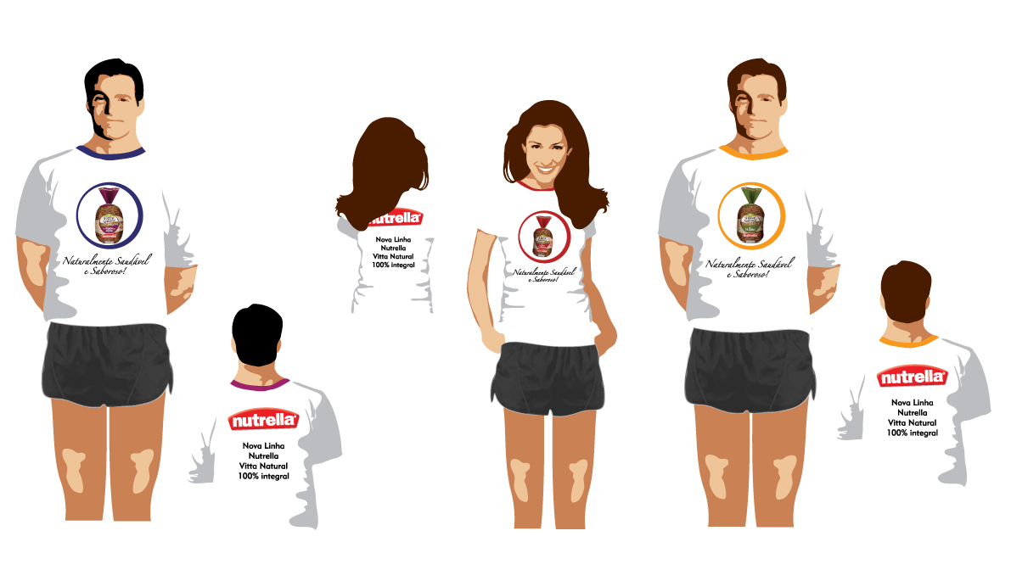
Sportsmen/ Sportswomen

Slide 63
Activation
Strategy
Blitz
Commute
Work
Books
Bookshop
Pairs of promoters
Bookshop
Airport
Magazines
Branded outfits
Main access gates
Tasting the new products
Offering water glasses – Engagement
Coffee Shop
Email
Internet
Home
Internet
Online Store
Supermarket
Sampling
All-Purpose Folder delivery – Positioning
Same days as the Sportsmen/women
Park
Park
Salon
Gym
Gym
Movie
Theatre
Restaurant
Mall
Pub
Night out

Slide 64
Activation
Strategy
Blitz
Commute
Work
Books
Bookshop
Monday to Friday
Mornings and Evenings
Bookshop
Airport
higher target density
Magazines
Coffee Shop
Where:
Email
Internet
Home
Internet
04 parks in São Paulo
01 park in Florianópolis
01 park in Porto Alegre
01 park in Curitiba
Online Store
Supermarket
Park
Park
Salon
Gym
Gym
Movie
Theatre
Restaurant
Mall
Pub
Night out

Slide 65
Activation
Strategy
Sponsorship
Commute
Work
Urban Furniture - Awareness + Engagement
Books
Bookshop
Bookshop
Airport
Magazines
Jogging track
adopting orientation and distance signs and rebranding them with positive and curious messages
Coffee Shop
Email
Internet
Home
Internet
Online Store
Fitness Equipment
Supermarket
Park
Donation of a set with 8 unique gym stations – “organic”
Brand visual guideline at the stations and “how-to” exercise boards.
Park
Salon
Gym
Gym
Movie
Theatre
Restaurant
Mall
Pub
Night out

Slide 66
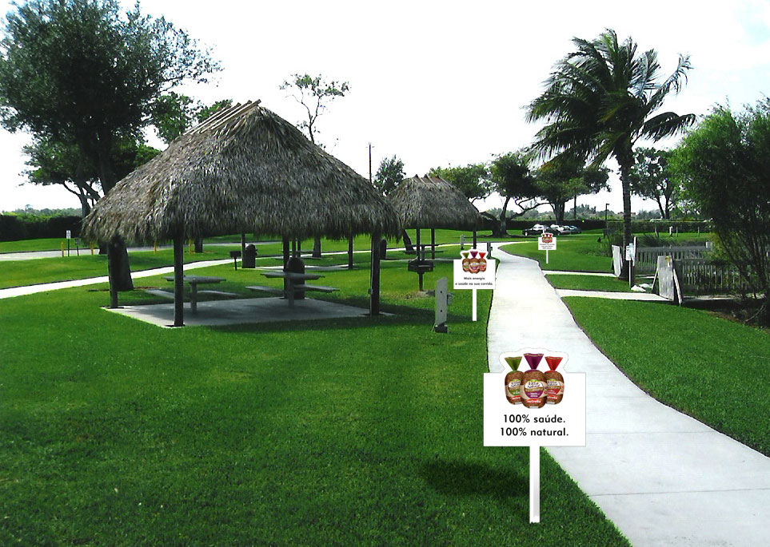
Jogging track

Slide 67
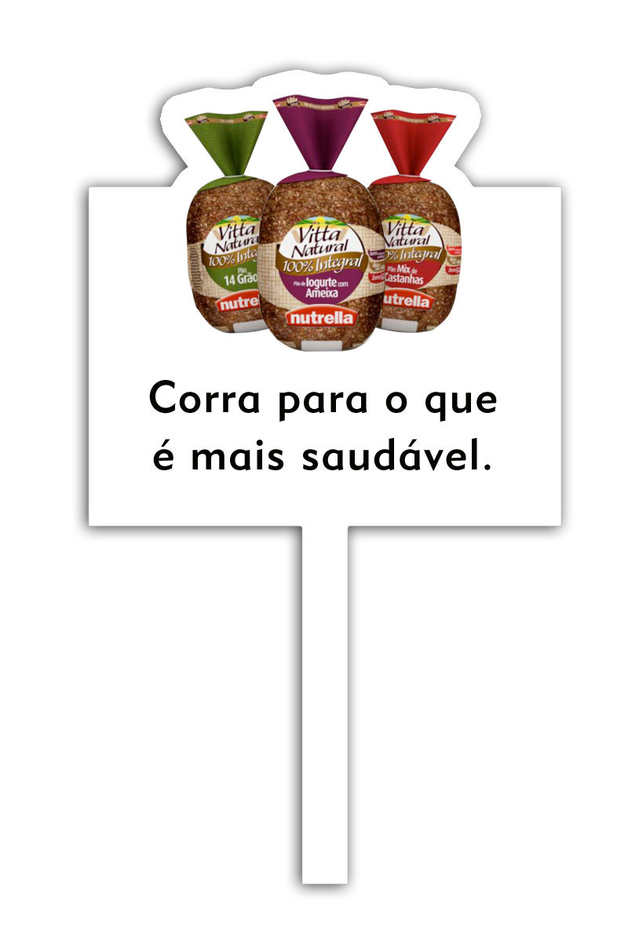
“run to where the health is”
Jogging track

Slide 68
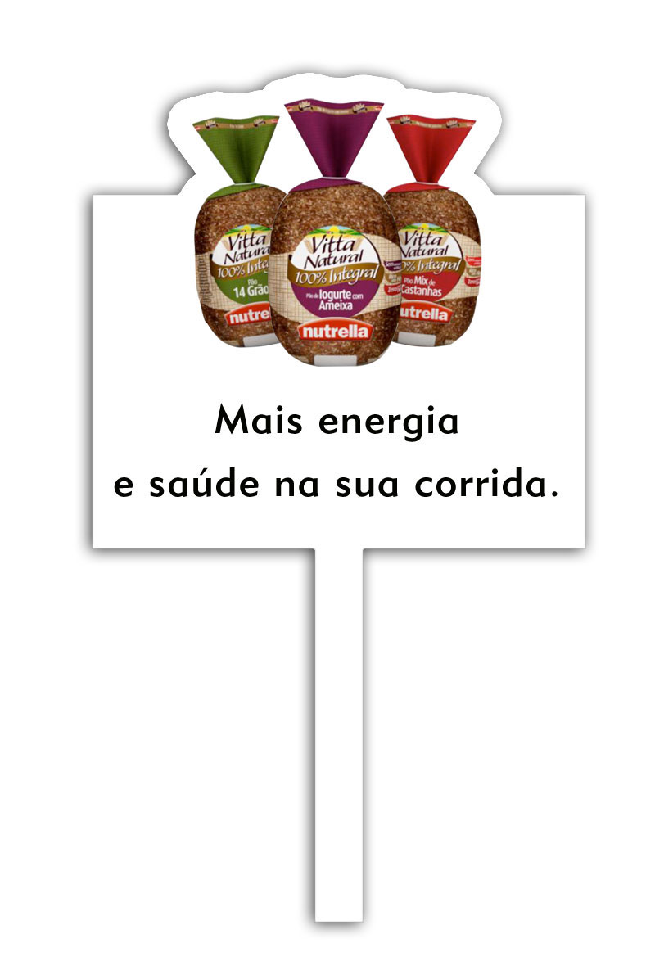
“more energy and health on your jogging”
Jogging track

Slide 69
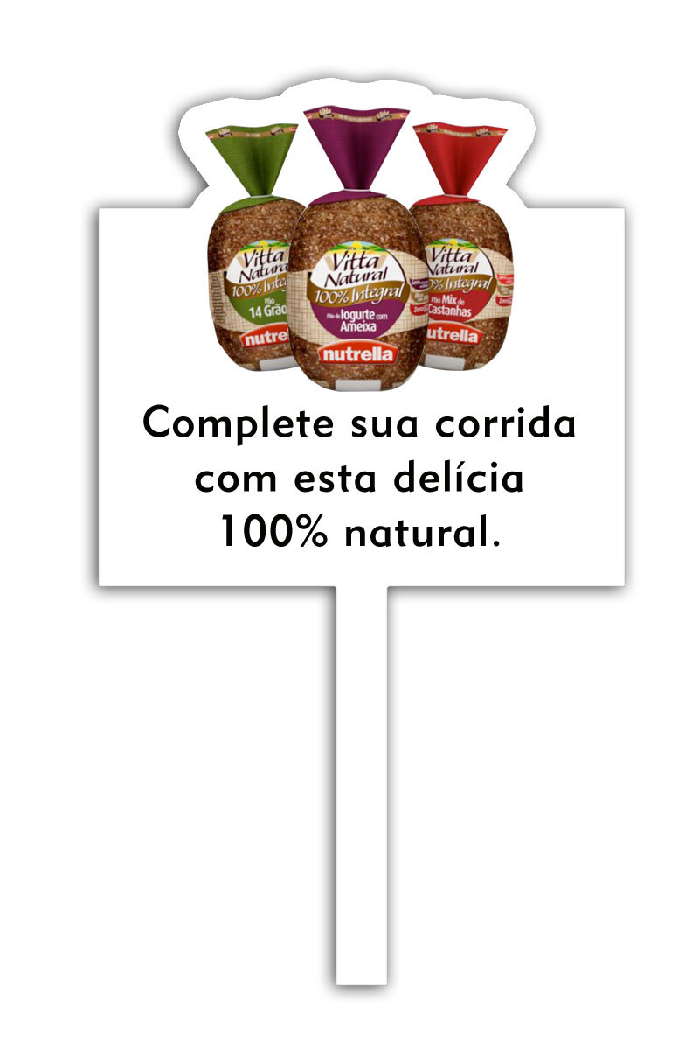
“End your run with this 100% natural pleasure”
Jogging track

Slide 70
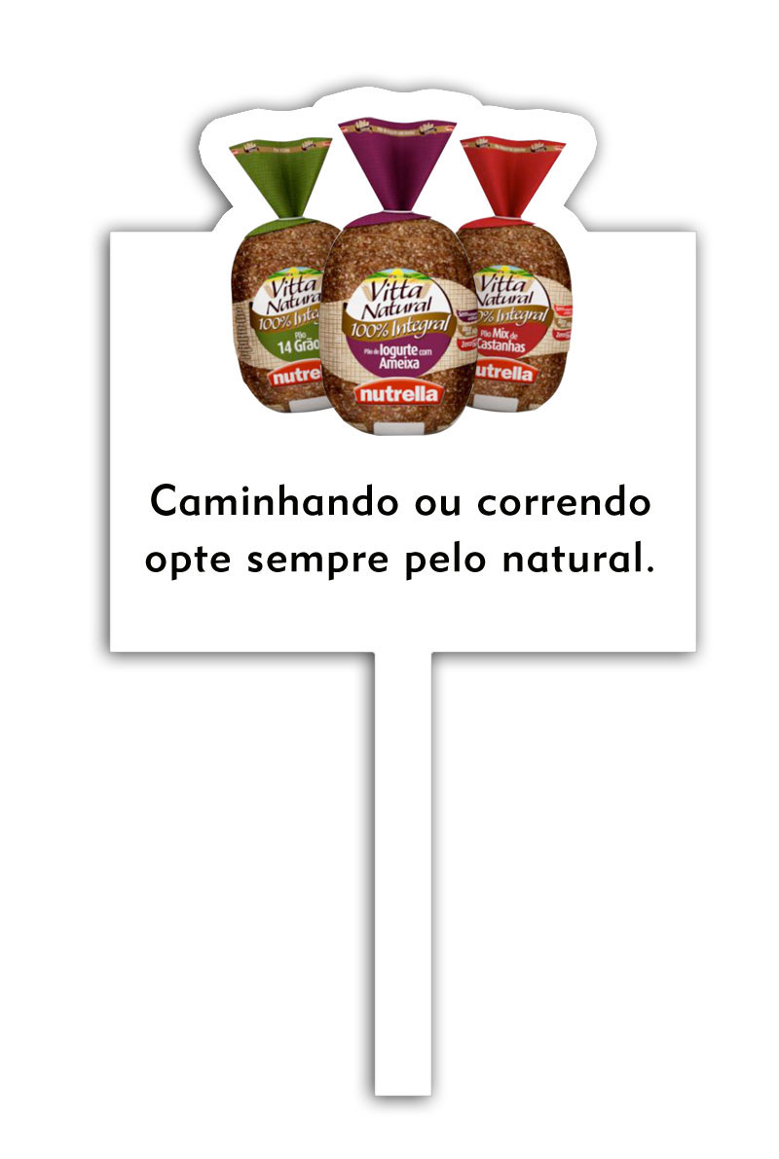
“Whether running or jogging, always look for the natural”
Jogging track

Slide 71
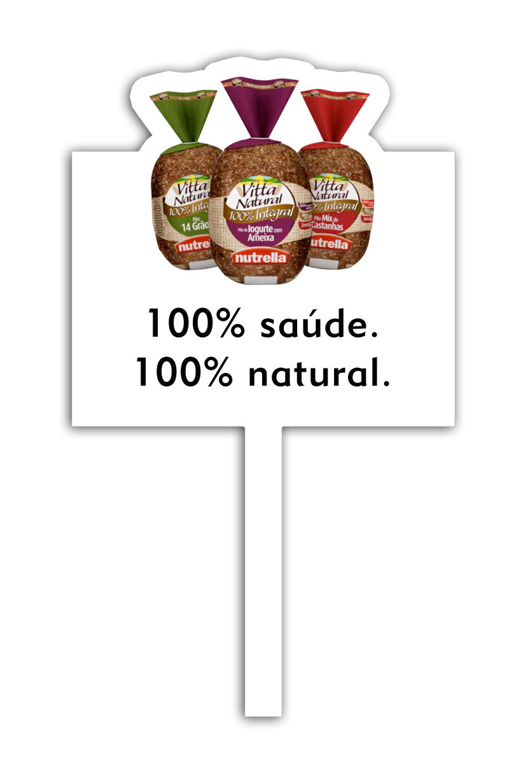
“100% healthy
100% natural”
Jogging track

Slide 72
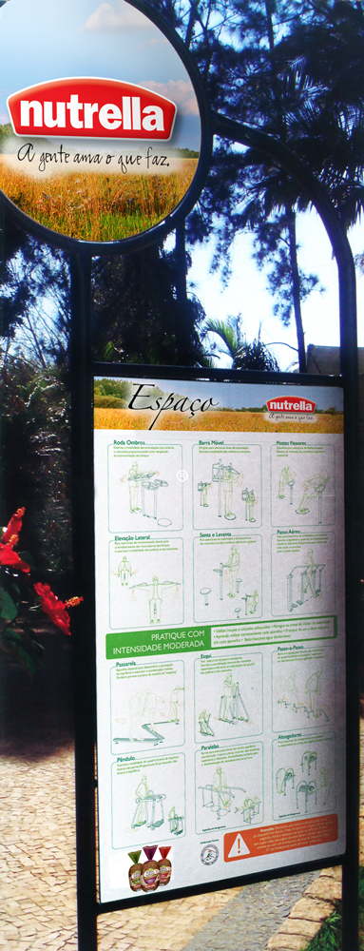
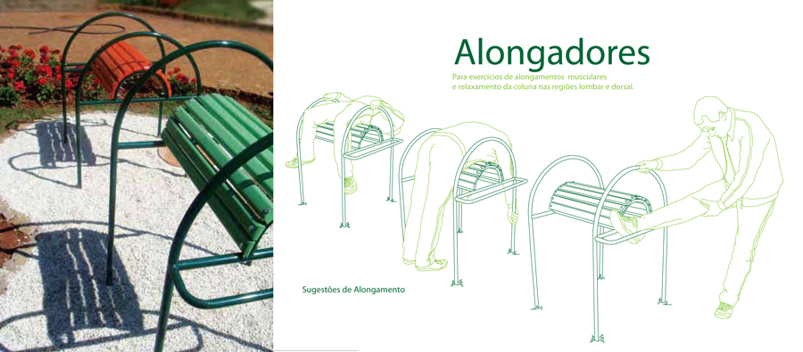
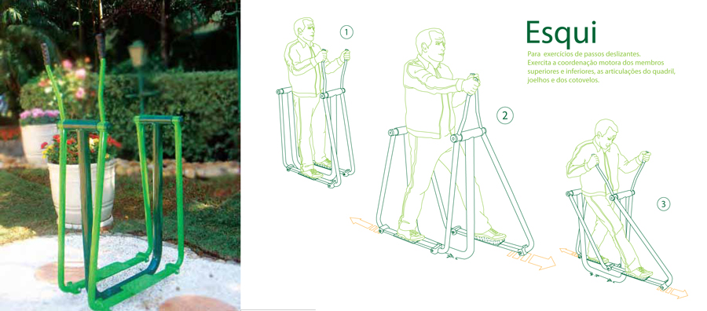
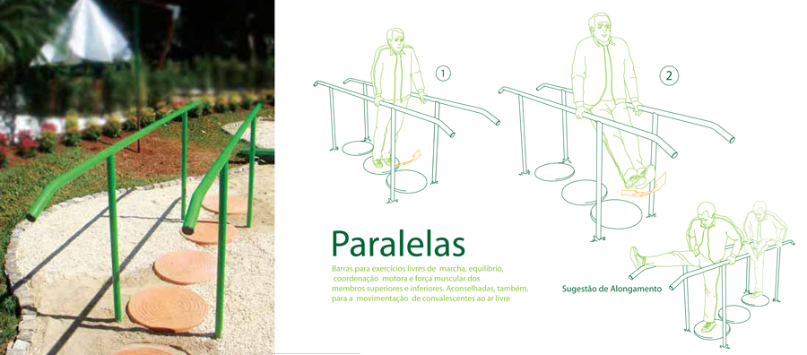
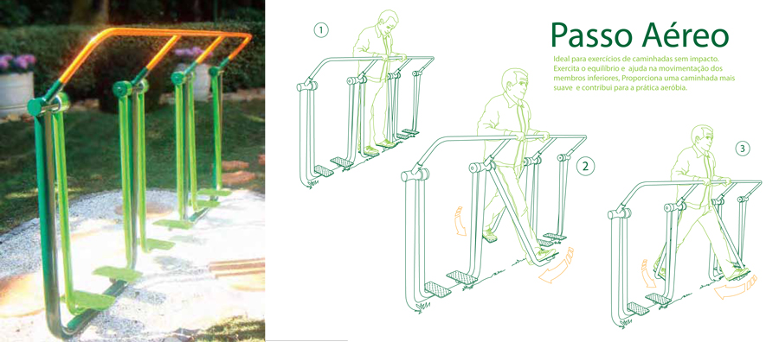
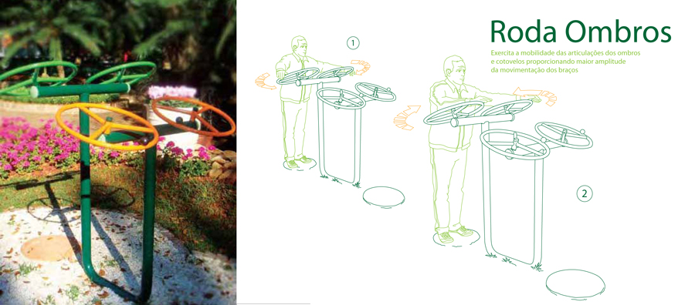
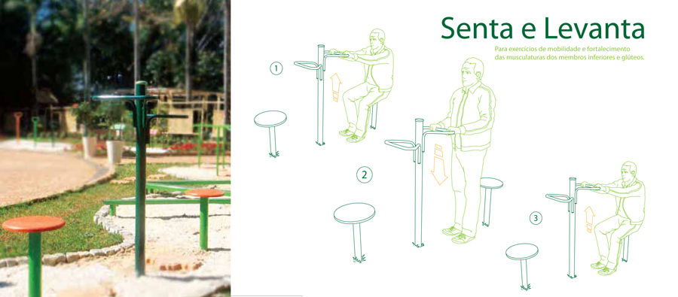
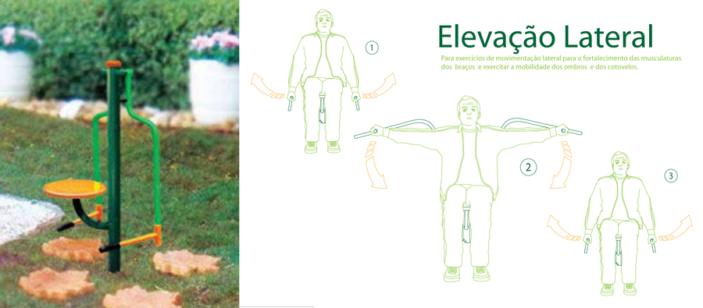
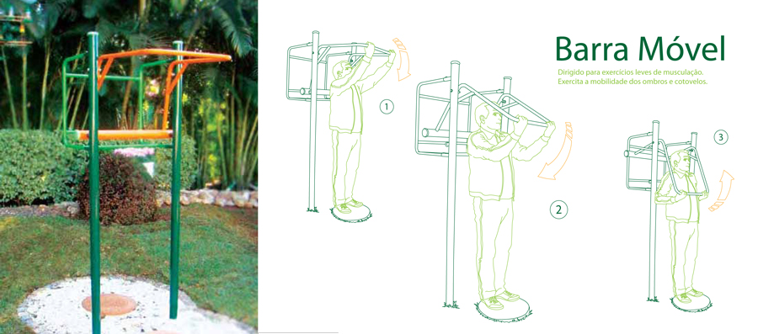
Sponsored Gym Stations

Slide 73
Sponsored Gym Stations

Slide 74
Sponsored Gym Stations

Slide 75
Sponsored Gym Stations

Slide 76
Sponsored Gym Stations

Slide 77
Sponsored Gym Stations

Slide 78
Sponsored Gym Stations

Slide 79
Sponsored Gym Stations

Slide 80
Sponsored Gym Stations

Slide 81
Activation
Strategy
Commute
Work
Commute
Books
Bookshop
Bookshop
Airport
Magazines
Coffee Shop
Email
Internet
Home
Internet
Online Store
Supermarket
Park
Park
Salon
Gym
Gym
Movie
Theatre
Restaurant
Mall
Pub
Night out

Slide 82
Activation
Strategy
Metro/ Destak Newspapers
Established channel at São Paulo
Commute
Work
Commute
Cover wrapper - health and well-being news
Second cover – tips and informations
Third and Fourth covers – launching campaign
Books
Bookshop
Bookshop
Airport
Magazines
Coffee Shop
Email
Internet
Home
Internet
Online Store
Paper boys – Branded vest – higher
visibility
Supermarket
Park
Park
Salon
Sampling
Gym
Gym
Movie
Theatre
Restaurant
Mall
Pub
Night out

Slide 83

Metro (Cover wrapper)

Slide 84

Destak (Cover wrapper)

Slide 85
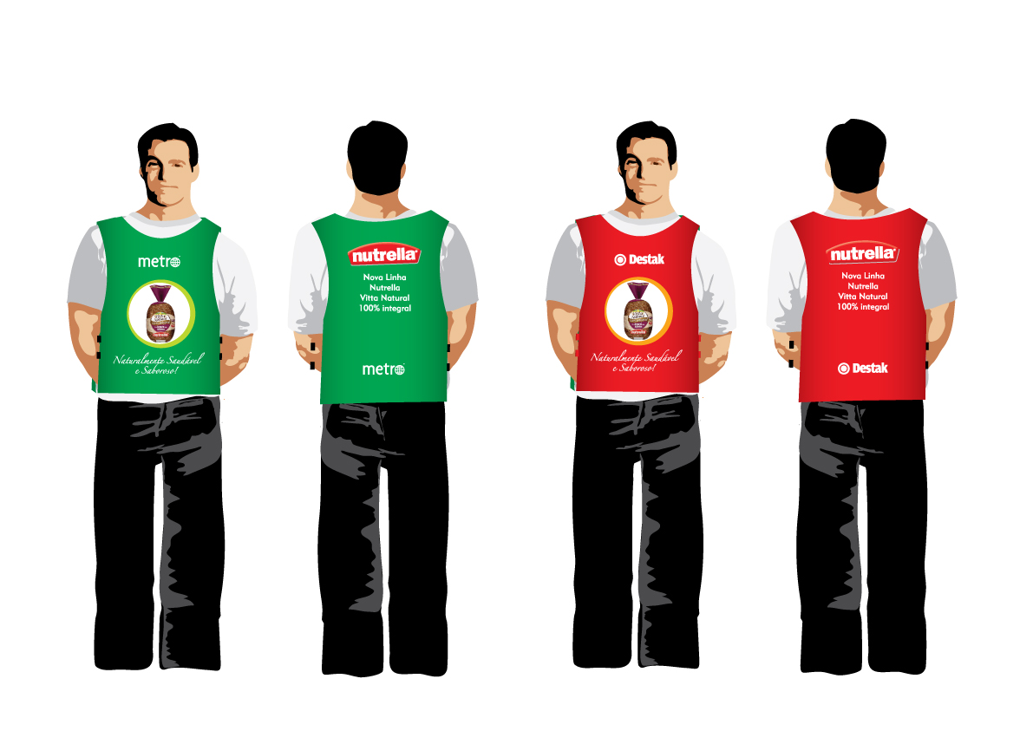
Paper boy (vests)

Slide 86
Activation
Strategy
Why Metro?
World’s biggest international newspaper
At São Paulo since 2007
Commute
Work
Commute
Books
Bookshop
Bookshop
Airport
Magazines
Target
Coffee Shop
homogeneous - 50% x 50%
70% less than 45 years old
urban, active, high graduate profile
Email
Internet
Home
Internet
Online Store
Supermarket
Park
Park
Salon
Gym
Gym
Movie
Theatre
Restaurant
Mall
Pub
Night out

Slide 87

Partnership
Women´s Health Magazine - Ed. Abril
Focus
Healthy habits, nutrition, fitness, beauty and womanly behaviour
POP
Unique insert
Assuming magazine’s concepts - positioning
Subscribers
Product samples
All-purpose folder

Slide 88

Magazine (insert)

Slide 89

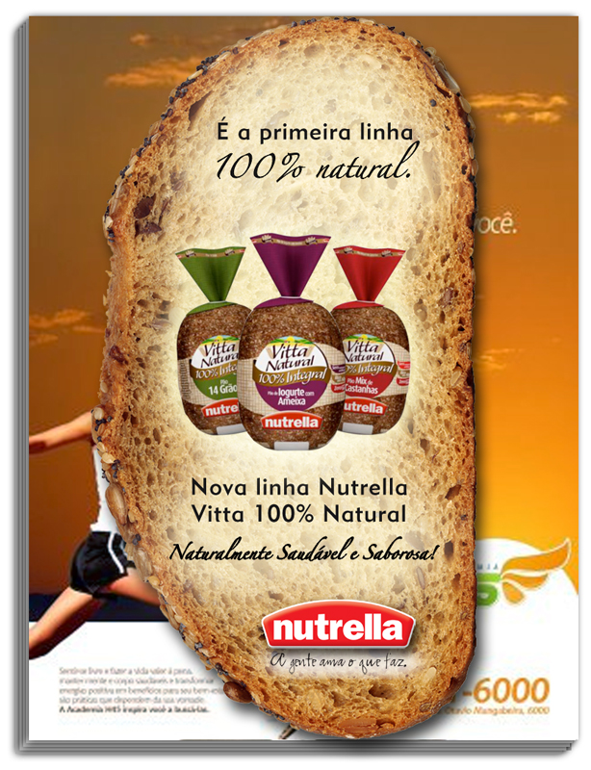
Magazine (insert)

Slide 90
Insert (front)

Slide 91
Insert (back)

Slide 92


Partnership
Women´s Health Magazine - Ed. Abril
Why Womens’s Health?
Printing – 64,000 mags/ month (audited)
Subscribers – 7,000+
Profile
Looking for products and services for a healthier lifestyle
Confidents and successful
Extremely demanding regarding reading
and buying
Habits
Readers who prefers:
- Nutrition over diet,
- Physical activities over pumping
- Steady results over miraculous
recipes

Slide 93
Actions
Summary
Commute
Work
Bookshop
Airport
Coffee Shop
Home
Internet
Supermarket
Park
Salon
Gym
Movie
Theatre
Restaurant
Mall
Pub
Night out

Slide 94
Actions
Summary
Metro/ Destak News
Insert and Sampling
Nutrella Shelf
Book Marker
Commute
Work
Bookshop
Airport
Coffee Shop
Virtual Shelf
AdWords
Home
Internet
Supermarket
Sportsmen
Blitz
Sponsorship
Tasting
Cross Merchandising
Nutrella Market
Park
Salon
Gym
Movie
Sponsored Class
Breakfast/ Noon
Health Menu
Parceria
Theatre
Restaurant
Mall
Insert
Sampling
Couvert
Pub
Night out

Slide 95
“Wow, Nutrella is natural and a 100% whole wheat. It should be really healthy!”
“Guess what?
Just saw at the market an ultra healthy product that seems to be so tasty.
I’ll definitely give it a try!”
“Those new flavours are so tasty.
In addition to that, there are no artificial conservatives!”
thank you

